Slide 1


Corrections, Completions, & Amendments to Vital Records
Theresa Roberts, Deputy State Registrar
Joseph Terry, Vital Records Representative
This Photo by Unknown Author is licensed under CC BY-SA

Slide 2

Legal Authority
Title 22 §2705 governs the requirements for the amendments for vital records. https://legislature.maine.gov/statutes/22/title22sec2705.html
Department rules 10-146 CMR Ch. 2 rules regulates the types of corrections, who may apply, the fee, and the documentary evidence required to support the correction. https://www.maine.gov/sos/cec/rules/10/chaps10.htm#146
Title 19A, Chapter 61 governs the requirements for the Maine Parentage Act. https://legislature.maine.gov/statutes/19-A/title19-Ach61sec0.html

Slide 3

Responsibilities of Municipal Clerks

Slide 4

Hospital Errors
BIRTH PORTION, PAGE 11
If an error is made by the hospital in which the child was born, the hospital may submit an electronic amendment in the DAVE system within 90 days after the birth record was filed.
Errors not corrected within the 90 days after the birth has been filed, requires the parent(s) who are listed on the birth record to submit a paper correction by using the VS-7 correction form.
Notes:
If the parents believe they did not make the error when they completed the parent worksheet at the hospital, they may contact the hospital to submit the correction. The hospital may submit the correction only if the parent worksheet contains the correct information. Otherwise, it will be up to the parents to submit the correction.

Slide 5


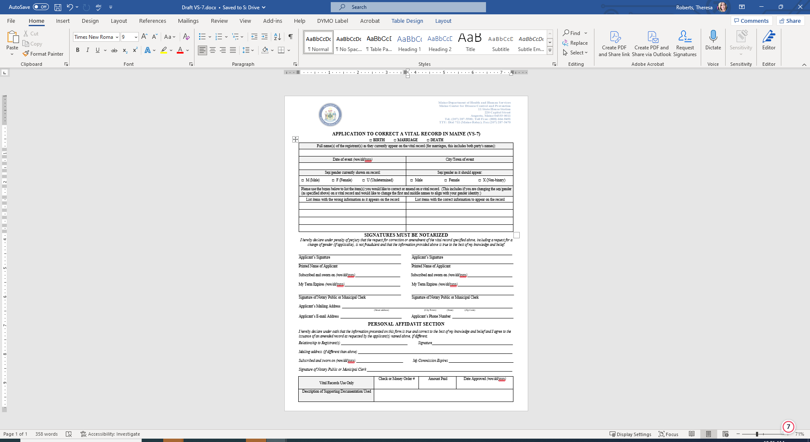
VS-7 Correction Form & Instructions

Slide 6

What other types of corrections or amendments require the VS-7 correction form to be completed?
The completion of an unnamed child.
The correction or amendment of any of the child’s or parents' information that appears on a certified copy of a birth record (including the spelling variations of a last name or when the first and middle names are reversed).
The amendment of the birth certificate of an adult (18 years or older) for the purpose of identifying or replacing a genetic parent who was not known or listed at the time of birth.
If the parents of a child have had a legal name changed by a court and would like to apply their new name(s) on the child’s record. (court orders are also required)
Changing the gender/sex field on a vital record and the first and middle names to align with their new gender identity.
Notes:
Talk about each type of correction.

Slide 7
Gender Identity (under 18)

Slide 8
Examples of Documents (VS-7 Instructions)
Personal affidavit – A parent or sibling having first-hand knowledge of the correct information may use a personal affidavit. The person signing the personal affidavit MUST be as old as or older than the applicant. Marriages: The Party A/Groom or Party B/Bride may use the personal affidavit to correct personal information on themselves, a municipal clerk may use the personal affidavit to correct a clerical error made by the municipal clerk, or the officiates may use the personal affidavit to correct information in the ceremony section. Deaths: the funeral director, authorized person or the informant may use the personal affidavit. The person completing the personal affidavit MUST sign the affidavit in the presence of a notary public or municipal clerk.
Officiates may also use the personal affidavit as a form of documentation when correcting errors in the ceremony section of a marriage certificate.
Intentions of marriage
Other documents (document must be at least 5 years old). Examples: Previous marriage record, death or birth certificate
Medical records
Records of employment, education, census, selective service or military service
Voter registration applications
Newspaper articles
For marriages: wedding guest book showing names of Party A/Groom or Party B/Bride and date
of marriage, church record
Notes:
Please Note
When using documentation to correct a vital record, the document(s) used MUST be original true attest copies or notarized copies and show the name of the person whose record is being corrected (as it should appear on the record) and the date of the event.
Original records submitted at the time of application will be returned to the applicants and notated on the bottom of the correction form. The cost for an correction after 90 days is $60.00 and includes a copy of the corrected record.
The normal processing time of a correction for vital records is 4-6 weeks.

Slide 9
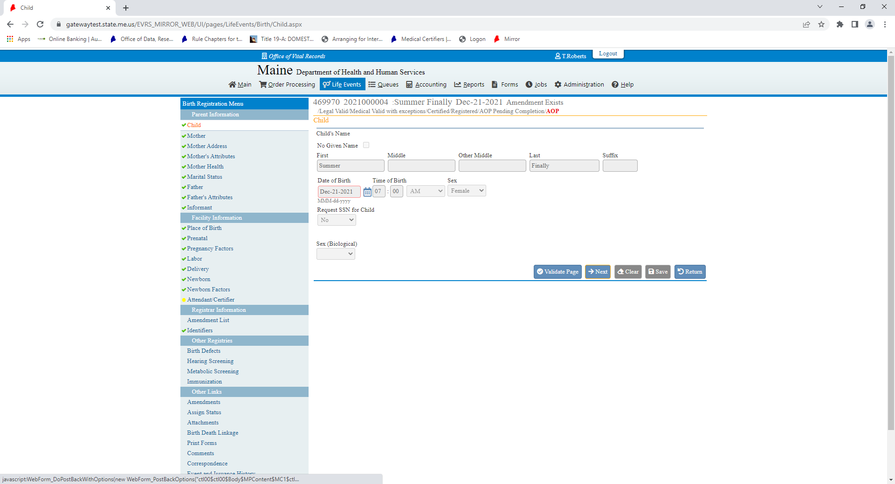
How will we be notified if there is a correction to one of our records?
Births from 1995 to present will be made electronically in the DAVE system.
Births prior to September of 1995 will be made to the paper records and a true attested copy of the corrected record, the approved VS-7 correction form and instructions will be mailed to the place of birth municipality and the municipality in which the mother resided.
Notes:
The red arrow shows when an correction or amendment has been done in the DAVE system. It is always recommended to search the record to ensure the correction has been done prior to issuing the record.
As a reminder, all amendments, corrections and completions to vital records must be submitted and corrected or completed by DRVS.
Corrections, completions and amendments made to vital records after 90 days must be marked amended and provide the documentation used to correct them and the date the amendment/correction was done.
Electronic records will contain the correction information in the marginal note of the record and paper corrections will contain the cross out of the incorrect information followed by the correct information typed above or to the side of the wrong information.

Slide 10
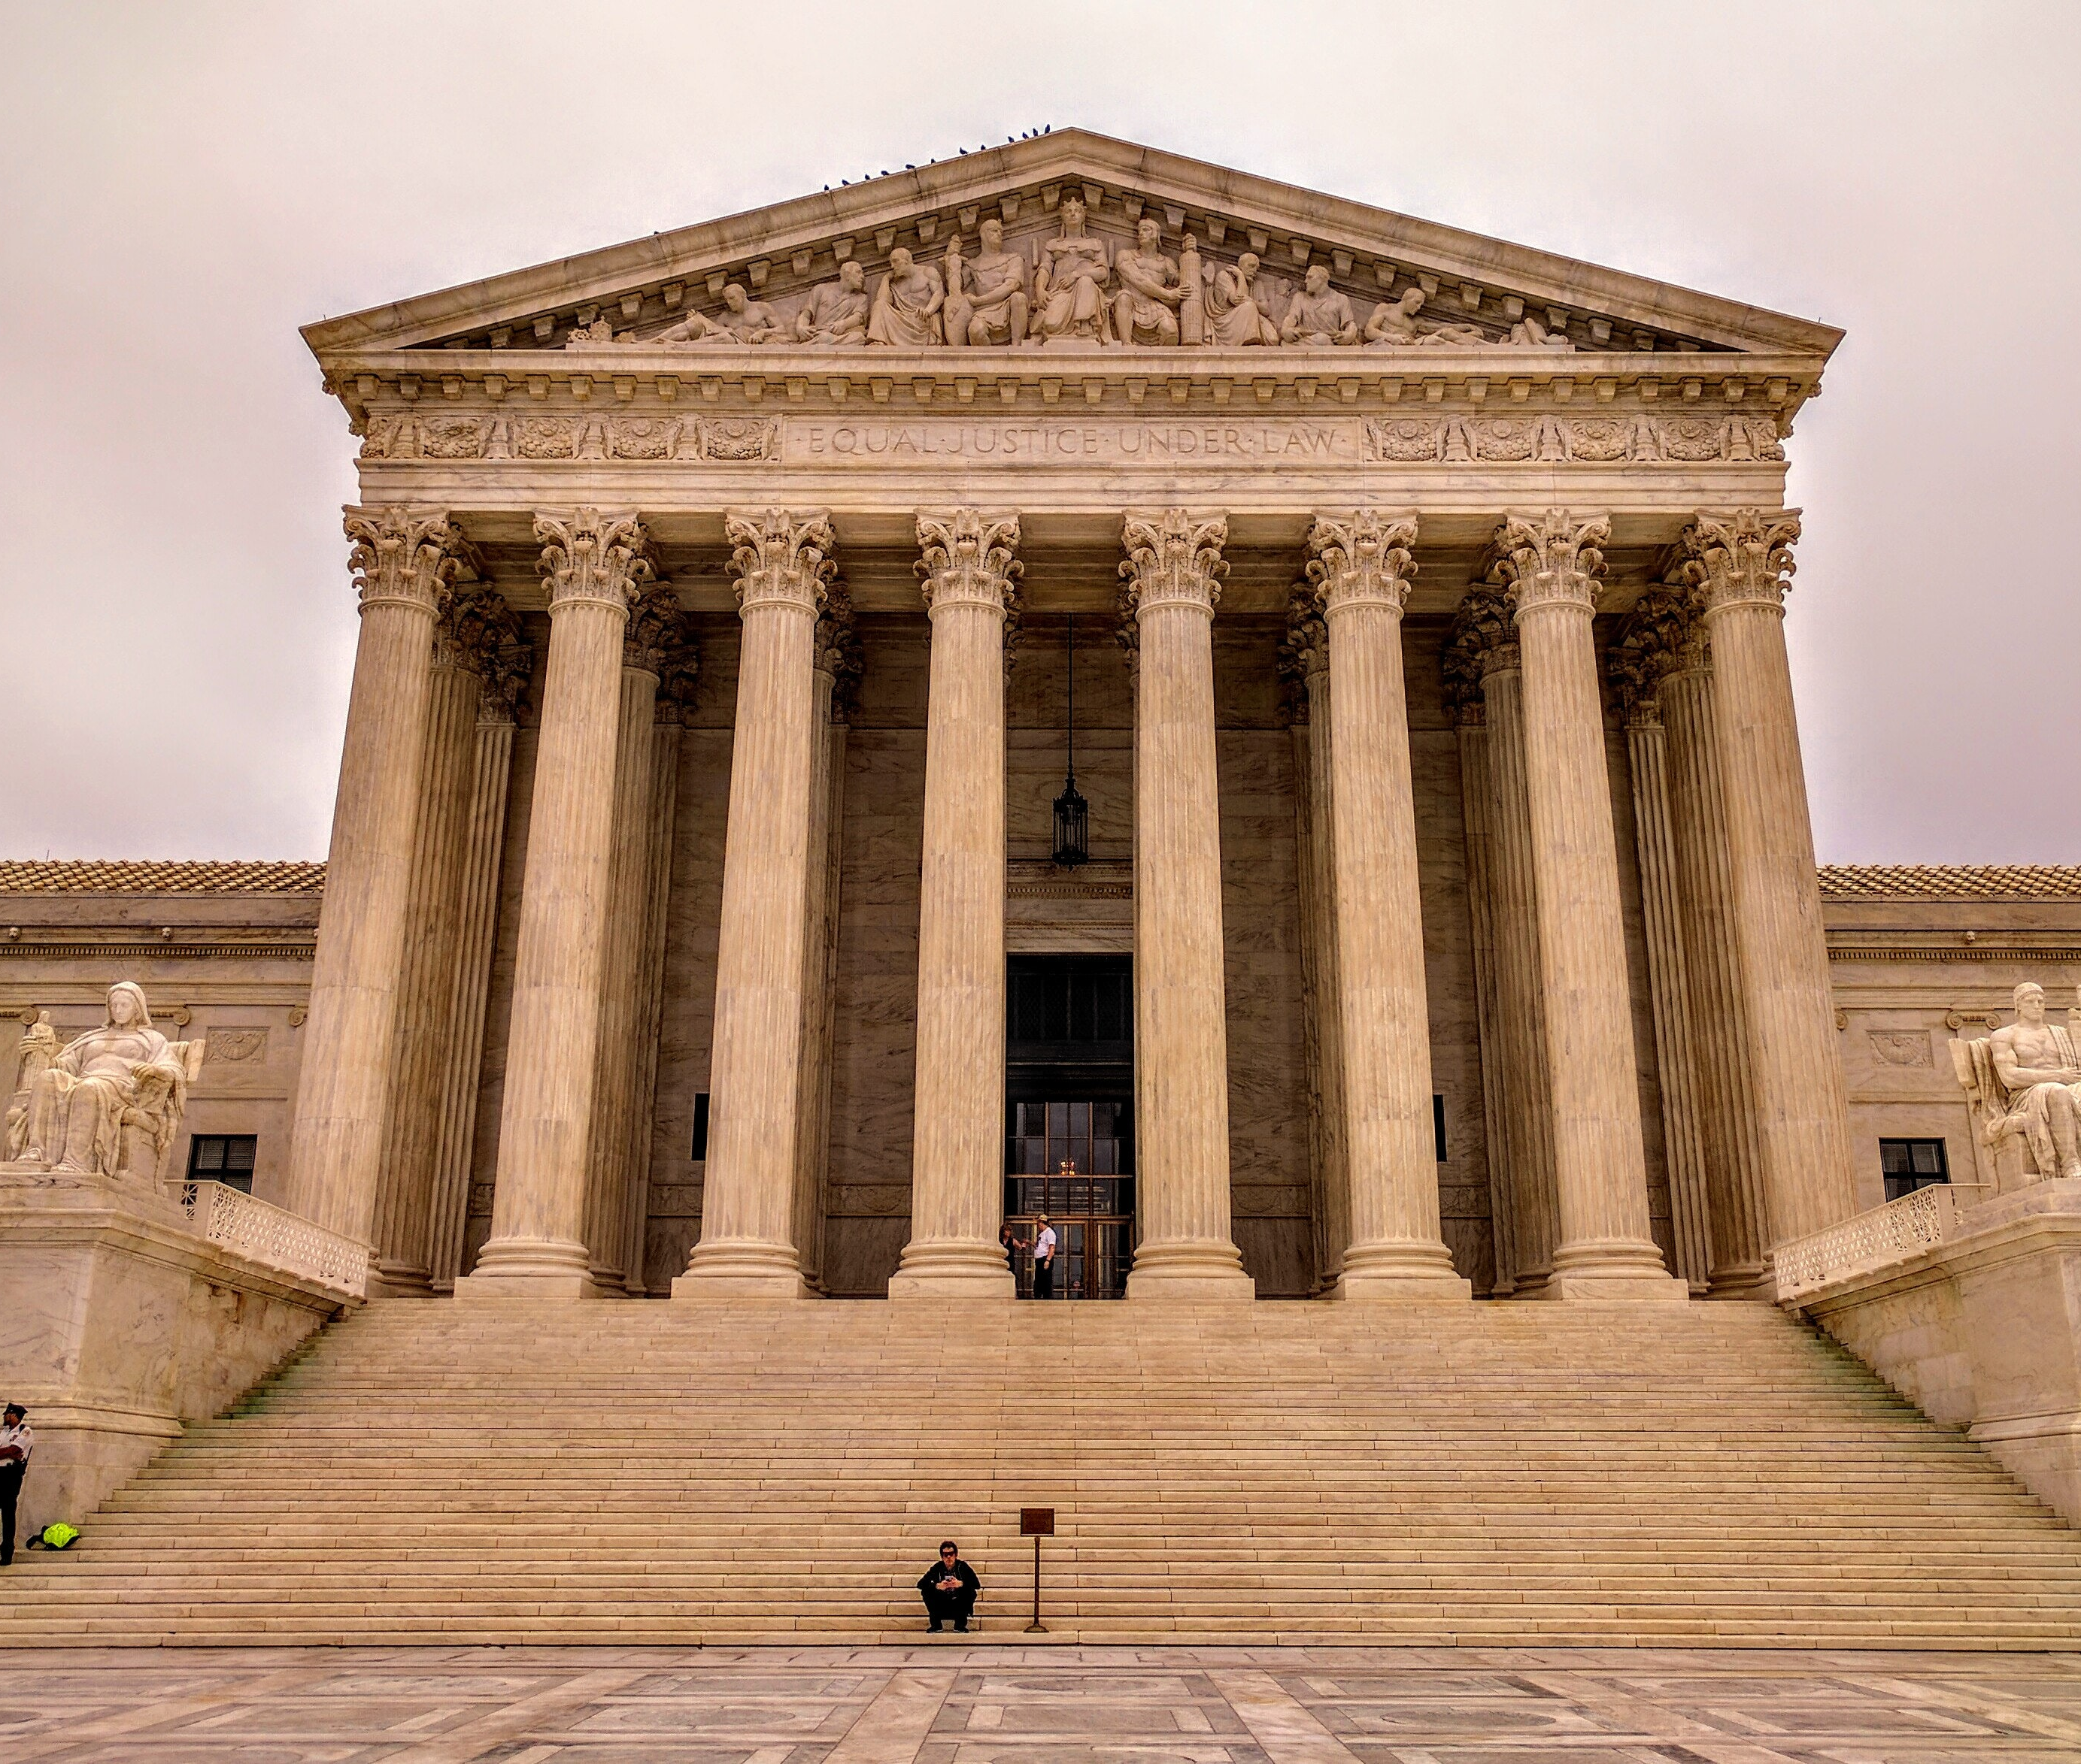
Legal Name Changes
Any changes to a last name (unless a spelling variation) or obtaining a new name all together must be done through a court of competent jurisdiction of the person listed on the vital record.
The court order that provides the old and new name, the VS-14 form signed and completed by a court or the divorce judgement/decree that states the new name after divorce, must be presented directly to DRVS.
Notes:
There is a $60.00 fee associated with any legal name change or court order but includes a certified copy of the amended birth record.

Slide 11

MAINE PARENTAGE ACT https://legislature.maine.gov/statutes/19-A/title19-Ach61sec0.html
1. Birth.
2. Court Ordered Adjudication.
2. Adoption.
3. Acknowledgment.
4. Presumption.
5. De facto parentage.
6. Genetic parentage.
7. Assisted reproduction.
8. Gestational carrier agreement.
9. Legitimation.

Slide 12

Adoption
BIRTH SECTION, PAGES 25-29
The adoption of a child is handled through the courts. Once DRVS receives the court order or (VS-9), the original record on file will be sealed and the record after adoption becomes the child’s legal birth certificate for the remaining of their life.
Notes:
The court will send the $60 fee associated with the cost of the replacement record after adoption which includes a copy of the birth record after adoption. The adoptive parents may choose to change the child's name or keep the original name and whether the record itself will show any annotations.
Adoptions to records from September of 1995 to present will be made in the DAVE system and the original record in DAVE will be sealed. Municipal clerks will not receive notification when an adoption occurs.
Adoptions to records prior to September of 1995 will be made by typing a replacement record which will be sent to the place of birth and mother’s resident municipality. Instructions for retrieval of the original record prior to adoption will be included. Ledger books containing the original birth record must be marked sealed to avoid the issuance of any information of the original record.

Slide 13
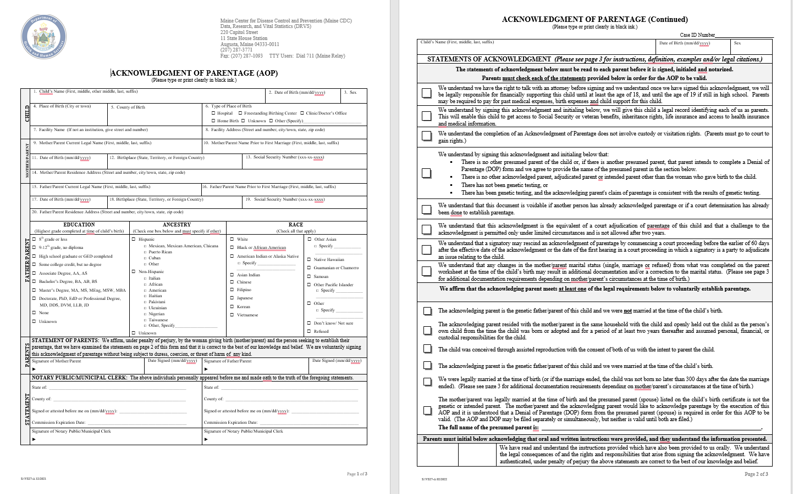
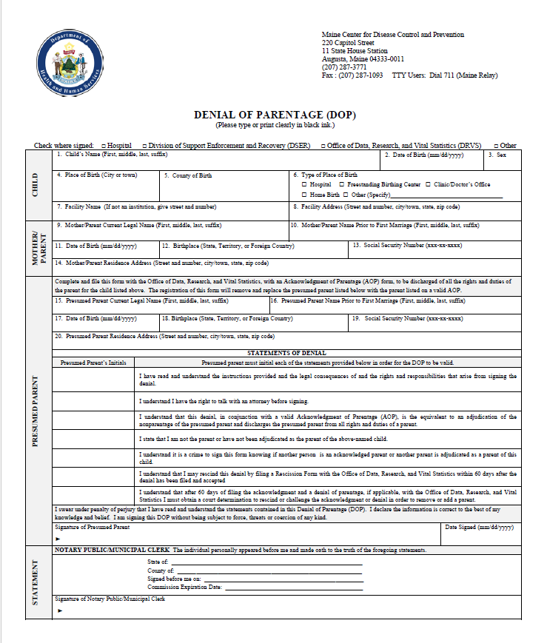
Acknowledgment of Parentage (AOP) & Denial of Parentage (DOP)
BIRTH SECTION, PAGES 19-21
Notes:
The following persons may sign an acknowledgment of parentage to establish parentage of a child:
Woman who gave birth. A woman who gave birth to the child and who is not a gestational carrier;
Alleged genetic parent. A person who is the alleged genetic parent of the child and who is not a donor;
Presumed parent. A presumed parent of the child, except that a presumed parent may not submit an acknowledgment of parentage for at least 2 years from the time the child was born or adopted; and
Intended parent. An intended parent of the child.

Slide 14
Legitimation
BIRTH SECTION, PAGE 25
Parents who were not married at the time of their child’s birth who later get married to each other after may apply for a Legitimation with DRVS.
Parents must complete the VS8 form, have their signatures notarized and provide a certified copy of their marriage certificate. This process changes the mother’s marital status from single to married and allows the parents to change the name of the child. The fee is $60.00 and includes a certified copy of the new birth record after legitimation.
The old record is sealed, and a new record is created. This process is similar to the adoption process for the creation and retrieval of the record prior to legitimation.

Slide 15

Please use the Q & A box to ask any questions. Thank you!

